Slide 1

Department of
Computer Science & Engineering
Subject: MiniProject II
Project Topic: CalmBand-Stress detection and Management System
Team members:
Shreya Sawant
Shreya Shivankar
Aarya Tupe
Guide name: Prof. Dipali Ghatge

Slide 2

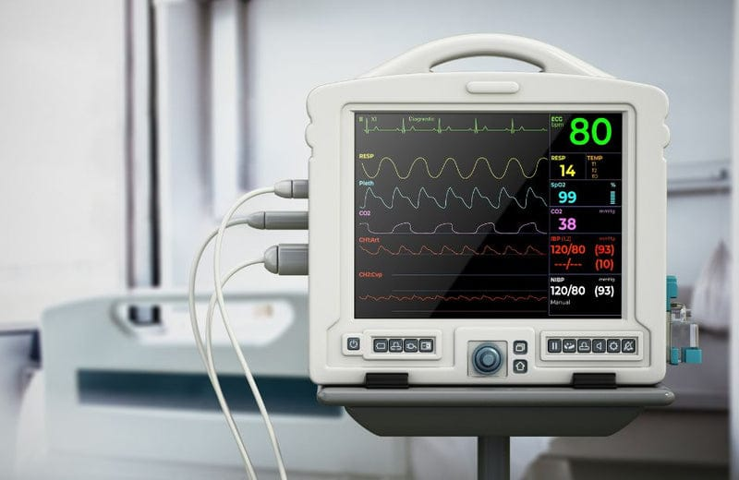
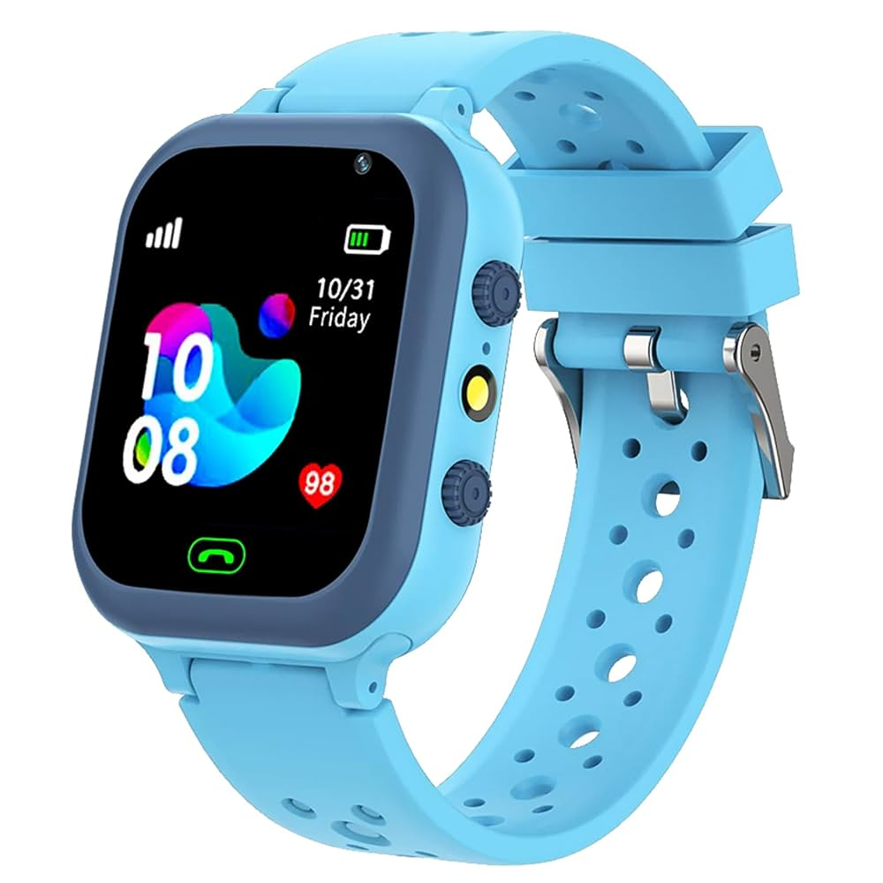
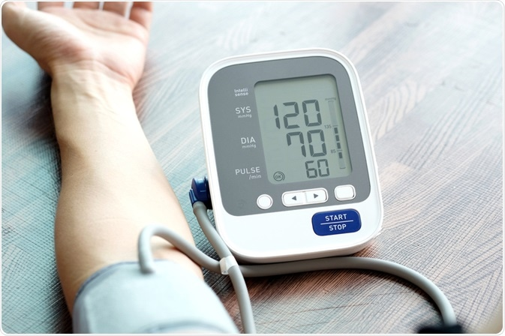
Existing System
Currently, stress detection is mostly done through:
Manual methods (questionnaires, self-assessment)
Clinical tools (EEG, ECG, blood pressure monitors)
Smart watches/fitness bands with basic heart rate tracking (e.g., Apple Watch, Fitbit)
Most of these systems are:
Expensive or not specialized for stress detection
Lack real-time feedback or relaxation guidance
Often do not combine multiple physiological parameters like HRV, GSR, and temperature

Slide 3
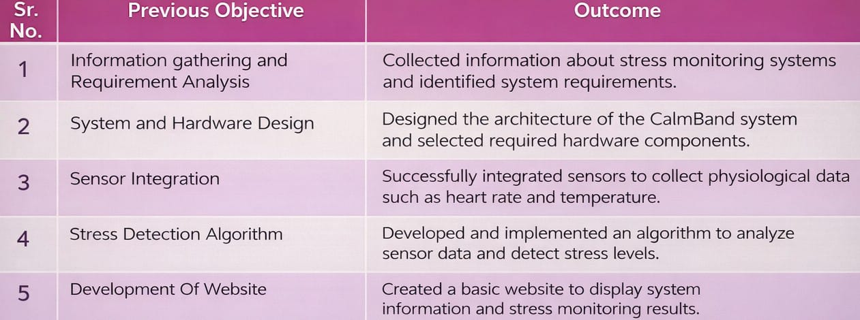
Previous Objectives

Slide 4
Objectives
1
To Collect Physiological Data for Stress Monitoring
2
To Develop a Personalized AI Assistant with Voice Support for Stress Management
3
4
To Design a More Compact and Comfortable CalmBand Device
To Analyze and Compare the CalmBand System with Existing Systems

Slide 5
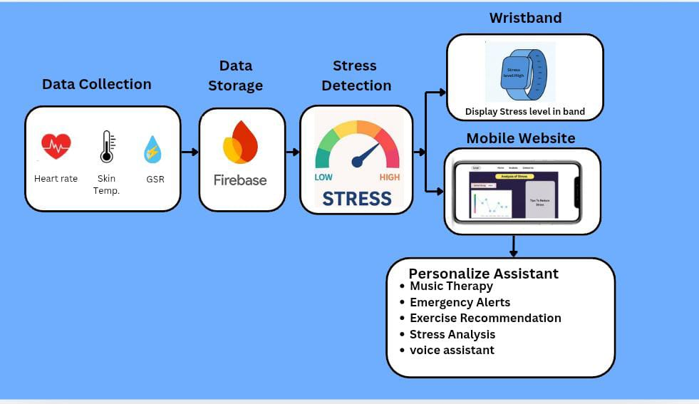
Overview Of Methodologies

Slide 6
Expected Outcome
Accurate Stress Detection: The system will be able to monitor and detect stress levels using physiological data such as heart rate and other sensor inputs.
Personalized Stress Management Support: Users will receive personalized suggestions and guidance through the AI assistant and voice interaction to help reduce stress.
Compact and User-Friendly Wearable Device: The CalmBand will be small, lightweight, and comfortable, making it suitable for continuous everyday use.

Slide 7
Advantages
Real-Time Stress Monitoring
Non-Invasive and Wearable Design
Immediate Alerts and Feedback
Compact and Portable
Health Awareness & Prevention
Bluetooth/IoT Connectivity

Slide 8
Limitations
Short Battery Life
Limited Features in Basic Prototype
Limitations

Slide 9


